Slide 1





Intelligent Solutions
ODOO RETAIL
INVENTORY PROJECT
Supervised By : DR. Elwy Rady

Slide 2



Our Team
Chart of the project
Overview
Business Analysis
Challenges
Solution and objectives
Implementation
Conclusion
Q&A
OUTLINES

Slide 3



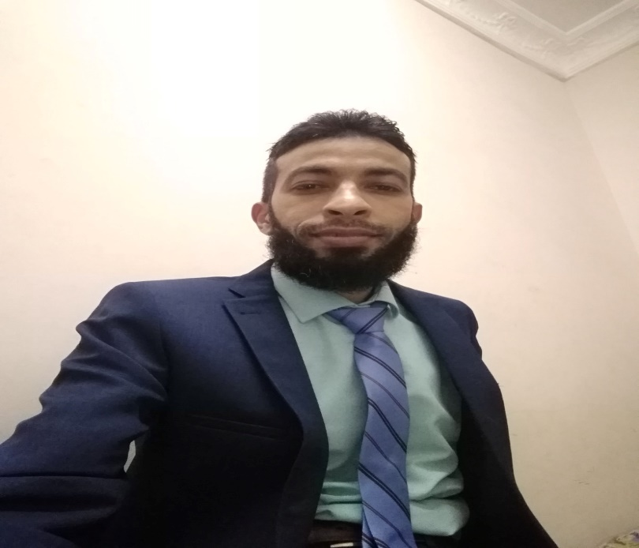

INTELLIGENT SOLUTIONS
Moustafa Mohamed
Mohga Mohamed
Mohamed Samir
Heba Salah
Team leader
Eman Ibrahim
Moustaf Ehab
Sondos Gharib

Slide 4

Retail
Inventory Project
Retail Inventory Project
1-Business Analysis
2-Challenges
3-Soution and objectives
4-Implementation

Slide 5


Overview of the project
Business Plan
Business Proposal
Implement Odoo for retail inventory to enhance accuracy, streamline operations, and improve customer satisfaction. The project includes thorough market analysis, resource allocation, a phased implementation plan, and risk management strategies. Expected ROI from reduced costs and increased efficiency will drive stakeholder support a
This proposal outlines the implementation of Odoo for retail inventory management to optimize stock control, enhance operational efficiency, and improve customer satisfaction. Key components include a phased deployment plan, training for staff, and ongoing support. The project aims to achieve significant cost savings and boost overall business performance.

Slide 6


Business Analysis
The business analysis identifies the need for Odoo in retail inventory management to address inefficiencies and inaccuracies. Key benefits include real-time tracking, streamlined processes, and improved reporting. Analyzing current workflows highlights gaps, while stakeholder feedback ensures alignment with business goals, paving the way for successful implementation and adoption.

Slide 7
Challenges
Inefficient inventory management leading to stockouts and overstocking.
Lack of real-time data affecting decision-making.
Manual processes causing delays and increasing human error.

Slide 8
Solution and objectives
The solution involves implementing Odoo to automate and optimize retail inventory management. Objectives include enhancing inventory accuracy, reducing stock discrepancies, improving order fulfillment speed, and providing real-time reporting. This will lead to better decision-making, increased operational efficiency, and elevated customer satisfaction, ultimately driving business growth and profitability.

Slide 9



Implementation phases
Phases 1
Phasee 2
Needs Assessment: "We began by assessing our current processes and identifying specific requirements.“
Customization: "Next, we customized Odoo modules to fit our business model."
Data Migration: "We carefully migrated existing data to ensure a smooth transition.“
Training and Support: "Comprehensive training sessions were conducted for our staff to ensure they are comfortable using the new system."

Slide 10
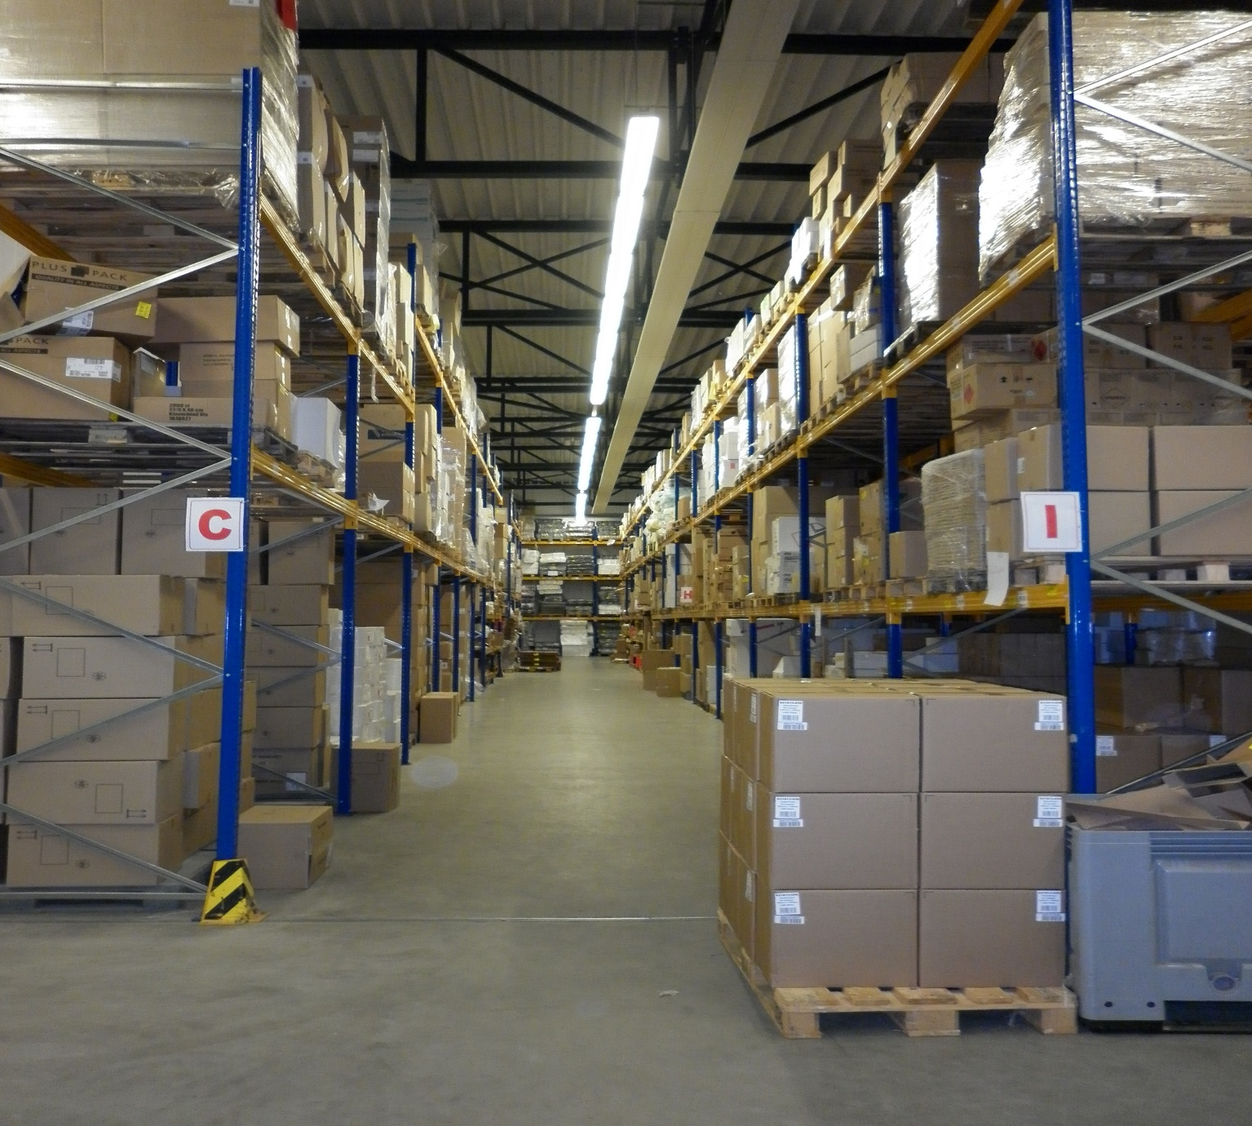

Go Live
Phase 3
Finally, we launched the system, with ongoing support to address any issues."
02

Slide 11


Thank you

